Slide 1

Java Database Connectivity
Slide Courtesy
Dr. Firoz Ahmed
Associate Professor
Department of ICE, RU
March 30th , 2014

Slide 2

OutLine
JDBC
JDBC drivers
The JAVA.sql packages
SQL
JDBC connection and Executing SQL
The process of building a JAVA application

Slide 3
JDBC
JDBC stands for “Java Data Base Connectivity”
The standard interface for communication between a Java application and a SQL database
Allows a Java program to issue SQL statements and process the results
JDBC provides methods for querying and updating the data in Relational Database Management system such as SQL, Oracle etc
Java Database Connectivity is similar to ODBC which is used for accessing and managing database
However, the difference is that JDBC is designed specifically for Java programs, where as ODBC is not depended upon any language

Slide 4

JDBC
JDBC helps the programmers to write java applications that manage three programming activities:
  It helps us to connect to a data source, like a database
  It helps us in sending queries and updating statements to the database
  Retrieving and processing the results received from the database in terms of answering to your query

Slide 5
JDBC Architecture
The following figure shows the JDBC architecture:
Java Application
JDBC API
JDBC Driver Manager
JDBC Drivers
Access
Database
Oracle
Database
Sybase
Database
Notes:
API (Application Programming Interface)

Slide 6
JDBC Architecture
Description of the Architecture:
Application: Application in JDBC is a Java applet or a Servlet that communicates with a data source.
JDBC API: Some important classes and interfaces defined in JDBC API are as follows:
  Driver Manager: Loads database drivers, and manages the connection between the application and the driver
  Driver: Translates API (Application Programming Interface) calls into operations for a specific data source
  Connection: A session between an application and a database
  Statement: An SQL Statement to perform a query or update operation
  Metadata: Information about returned data, the database and the driver
  ResultSet: Logical set of columns and rows returned by executing an SQL statement

Slide 7
JDBC Architecture
Driver Manager: The Driver Manager plays an important role in the JDBC architecture. The Driver manager uses some database-specific drivers that effectively connect enterprise applications to databases.
JDBC Drivers: JDBC drivers help us to communicate with a data source through JDBC. We need a JDBC driver that can intelligently interact with the respective data source.

Slide 8
The 5 Steps Approach to JDBC
There are following five steps to create the database connection with Java application:
  Loading the Driver: Class.forName() method is used to load the driver class dynamically. Example: Class.forName("net.ucanaccess.jdbc.UcanaccessDriver");
  Create Connection: The DriverManager class provides the getConnection() method to establish connection object. Example: Connection con = DriverManager.getConnection(“jdbc:ucanaccess://D:\\database.accbd”);
  Create SQL Statement: The Connection interface provides the createStatement() method to create SQL statement. Example: Statement stmt = con.createStatement();
  Execute the query: Statement interface provides the executeQuery( ) method to execute SQL statements. Example: ResultSet rs = stmt.executeQuery("select * from students");
  Close the connection: The Connection interface provides close( ) method, used to close the connection. Example: con.close( );

Slide 9
JDBC Pseudo Code
„ All JDBC programs do the following:
Step 1: load the JDBC driver
Step 2: Specify the name and location of the database being used
Step 3: Connect to the database with a Connection object
Step 4: Execute a SQL query using a Statement object
Step 5: Get the results in a ResultSet object
Step 6: Finish by closing the ResultSet, Statement and Connection objects

Slide 10


JDBC Driver
Java application
Database Server
JDBC Driver

Slide 11
JDBC Driver
There are four types of JDBC drivers
  Type 1
    JDBC-ODBC bridge plus ODBC driver
  Type 2
    Native-API, partly Java driver
  Type 3
    JDBC-Net, pure Java driver
  Type 4
    Native-protocol, pure Java driver

Slide 12
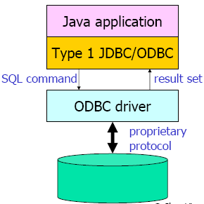
Type 1: JDBC-ODBC bridge plus ODBC driver
It is a database driver implementation that employs the ODBC driver to connect to the database
The driver converts JDBC method calls into ODBC function calls
The bridge is usually used when there is no pure-Java driver available for a particular database
The driver is platform-dependent as it makes use of ODBC
The use of this driver is discouraged if the alternative of a pure-Java driver is available
A JDBC-ODBC bridge provides JDBC API access via one or more ODBC drivers

Slide 13
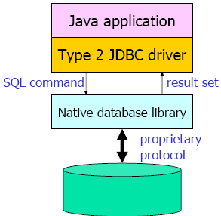
Type 2: Native-API, partly Java driver
It is a database driver implementation that uses the client-side libraries of the database
The driver converts JDBC method calls into native calls of the database API
A native-API partly Java technology-enabled driver
Proprietary protocol is a communications protocol owned by a single organization or individual.
However, it provides more functionality, performance and faster than the type 1 drive

Slide 14
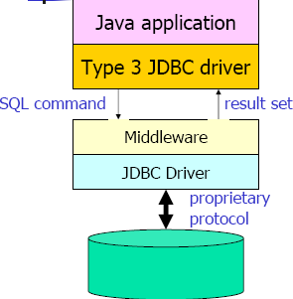
Type 3.: JDBC-Net, pure Java driver
It is a database driver implementation which makes use of a middle-tier between the calling program and the database
The middle-tier converts JDBC calls directly or indirectly into the vendor-specific database protocol
It is platform-independent and fully Java technology-enabled driver
This net server middleware is able to connect all of its Java technology-based clients to many different databases
JDBC drivers are the most flexible JDBC solution because they do not require any native binary code on the client and it does not need any client installation (Example: ucanaccess driver)

Slide 15
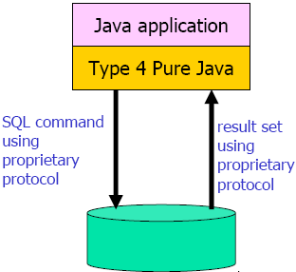
Type 4.: Native-protocol, pure Java driver
It is a database driver implementation that converts JDBC calls directly into the vendor-specific database protocol
It is platform independent and installed inside the Java Virtual Machine of the client
It provides better performance over the type 1 and 2 drivers
It may not be suitable for some applications if the underlying protocol does not handle issues such as security and network connectivity well

Slide 16
The java.sql package
Making a connection with a database with the help of DriverManager class
Sending SQL Parameters to a database
Updating and Retrieving the Results of a Query
Providing Standard mappings for SQL types to classes and interfaces in Java Programming language
Exceptions
Custom mapping an SQL user- defined type (UDT) to a class in the java programming language.

Slide 17
Making a connection with DriverManager class
DriverManager class
  It helps to make a connection with the driver
SQLPermission class
  It provides a permission when the code is running within a Security Manager, such as an applet.
  It attempts to set up a logging stream through the DriverManager class
Driver interface
  This interface is mainly used by the DriverManager class for registering and connecting drivers based on JDBC technology
DriverPropertyInfo class
  This class is generally not used by the general user

Slide 18
Sending SQL Parameters to a Database
Some important classes and interfaces defined in JDBC are as follows:
Statement interface
  It is used to send basic SQL statements
PreparedStatement interface
  It is used to send prepared statements or derived SQL statements from the Statement object
CallableStatement interface
  This interface is used to call database stored procedures
Connection interface
  It provides methods for creating statements and managing their connections and properties
Savepoint
  It helps to make the savepoints in a transaction

Slide 19
Updating and Retrieving the Results of a Query
ResultSet interface
  This object maintains a cursor pointing to its current row of data

Slide 20
SQL
The commonly used SQL statements are
  Select
  Insert
  Update
  Delete

Slide 21
SQL Select statement
The SELECT statement is used to select data from a table
  Syntax
    Select column_names FROM table_name;
The SELECT statement has mainly three clauses
  Select
    The Select specifies the table columns that are retrieved
  From
    The From clause tells from where the tables has been accessed
  Where
    The Where clause specifies which tables are used. The Where clause is optional, if not used then all the table rows will be selected

Slide 22
SQL Insert Statement
This statement allows you to insert a single or multiple records into the database
We can also specify the name of the column in which we want to insert the data
  Syntax:
    Insert into table name values (value1, value2..);
The Insert statement has mainly three clauses
  Insert
    It specifies which table column has to be inserted in the table
  Into
    It tells in which the data will be stored
  Values
    In this we insert the values we have to insert

Slide 23
The UPDATE Statement
The Update statement is used to modify the data in the table
Whenever we want to update a row then we use the Update statement
  The syntax is
    UPDATE table_name Set colunm_name = new_value WHERE column_name = some_name;
The Update statement has mainly three clauses
  Update
    It specifies which table column has to be updated
  Set
    It sets the column in which the data has to be updated
  Where
    It tells which tables are used

Slide 24
SQL Delete Statement
This delete statement is used to delete rows in a table
  Systax:
    DELETE FROM table_name WHERE column_name = some_name;
The Delete statement has following clauses
  Delete
    It specifies which table column has to be deleted
  From
    It tells from where the Table has been accessed
  Where
    It tells which tables are used

Slide 25
JDBC connection and Executing SQL
Loading a JDBC Driver
Connecting to a Database
Executing SQL
Processing the Results
Closing Database Connection

Slide 26
JDBC Programming Steps
Connect
Register the driver
Create a connection to the database
Query
Create a statement
Query the database
Process
Results
Get a result set
Assign results to Java variables
Close the result set
Close the statement
Close the connection
Close

Slide 27


Skeleton Code
Class.forName(DRIVERNAME);
Connection con = DriverManager.getConnection(
CONNECTIONURL, DBID, DBPASSWORD);
Statement stmt = con.createStatement();
ResultSet rs = stmt.executeQuery(“SELECT a, b, c FROM member);
while(rs.next())
{
  int x = rs.getInt(“a”);
  String s = rs.getString(“b”);
  float f = rs.getFloat(“c”);
}
rs.close();
stmt.close();
con.close();
Loading a JDBC driver
Connecting to a database
Closing the connections
Notes:
Skeleton mean frame, framework, diagram, bone….etc

Slide 28
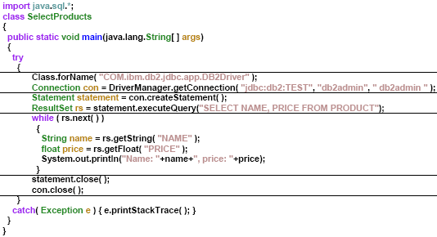

Example

Slide 29
Loading a JDBC Driver
A JDBC driver is needed to connect to a database
Loading a driver requires the class name of the driver
  JDBC-ODBC: sun.jdbc.odbc.JdbcOdbcDriver
  Oracle driver: oracle.jdbc.driver.OracleDriver
  MySQL: com.mysql.jdbc.Driver
  UCanAccess: net.ucanaccess.jdbc.UcanaccessDriver
Loading the driver class
Class.forName("com.mysql.jdbc.Driver");
It is possible to load several drivers
The class DriverManager manages the loaded driver(s)

Slide 30
Connecting to a Database
JDBC URL for a database
  Identifies the database to be connected
  Consists of three-part:
  jdbc:<subprotocol>:<subname>
Protocol: JDBC is the only protocol in JDBC
Sub-protocol: identifies a database driver
Protocol: JDBC is the only protocol in JDBC
Sub-protocol: identifies a database driver
Subname: indicates the location and name of the database to be accessed.
Subname: indicates the location and name of the database to be accessed. Syntax is driver
Ex) jdbc:mysql://oopsla.snu.ac.kr/mydb

Slide 31
Connecting to a Database
The DriverManager allows to connect to a database using the specified JDBC driver, database location, database name, username and password
It returns a Connection object which can then be used to communicate with the database
Connection connection = DriverManager.getConnection
("jdbc:mysql://oopsla.snu.ac.kr/mydb",“userid",“password");
JDBC URL
Vendor of database, Location of database server and name of database
Username
Password

Slide 32
Executing SQL
Statement object
  Can be obtained from a Connection object
  Sends SQL to the database to be executed
Statement has three methods to execute a SQL statement
  executeQuery() for QUERY statements
    Returns a ResultSet which contains the query results
  executeUpdate() for INSERT, UPDATE, DELETE, or DDL statements
    Returns an integer, the number of affected rows from the SQL
  execute() for either type of statement
Statement statement = connection.createStatement();

Slide 33
Executing SQL
Execute a select statement
Statement stmt = conn.createStatement();
ResultSet rset = stmt.executeQuery
("select RENTAL_ID, STATUS from ACME_RENTALS");
Execute a delete statement
Statement stmt = conn.createStatement();
int rowcount = stmt.executeUpdate
("delete from ACME_RENTAL_ITEMS where rental_id = 1011");
Notes:
Dynamically Executing an Unknown SQL Statement
The following example uses execute() to dynamically execute an unknown statement:
public void executeStmt (String statement) throws SQLException {
Statement stmt = conn.createStatement();
// Execute the statement
boolean result = stmt.execute(statement);
if (result) { // statement was a query
ResultSet rset = stmt.getResultSet();
// Process the results
...
}
else { // statement was an update or DDL
int updateCount = stmt.getUpdateCount();
// Process the results
...
}
}

Slide 34
Processing the Results
JDBC returns the results of a query in a ResultSet object
  ResultSet object contains all of the rows which satisfied the conditions in an SQL statement
A ResultSet object maintains a cursor pointing to its current row of data
  Use next() to step through the result set row by row
    next() returns TRUE if there are still remaining records
Internal Pointer
ResultSet
Record 1
Record 2
Record 3
Record 4
The internal pointer starts one before the first record

Slide 35
Processing the Results
Example
  Statement stmt = con.createStatement();
  ResultSet rs = stmt.executeQuery(“SELECT ID, name, score FROM table1”);
  while (rs.next()){
    int id = rs.getInt(“ID”);
    String name = rs.getString(“name”);
    float score = rs.getFloat(“score”);
    System.out.println(“ID=” + id + “ ” + name + “ ” + score);}
You must step the cursor to the first record before read the results This code will not skip the first record
ID | name | score
1 | James | 90.5
2 | Smith | 45.7
3 | Donald | 80.2
Output
ID=1 James 90.5
ID=2 Smith 45.7
ID=3 Donald 80.2
Table1

Slide 36
Closing Database Connection
It is a good idea to close the Statement and Connection objects when you have finished with them
  Close the ResultSet object
rs.close();
  Close the Statement object
stmt.close();
  Close the connection
  connection.close();

